Slide 1
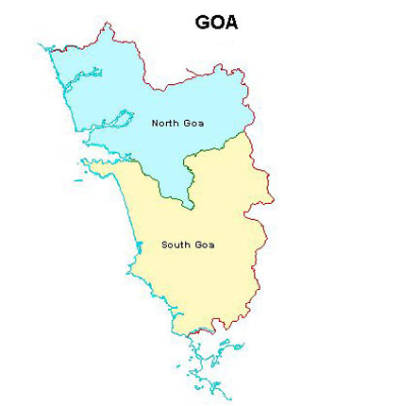
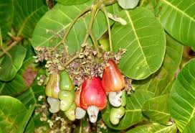
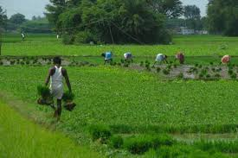
MID DAY MEAL SCHEME
DIRECTORATE OF EDUCATION GOVERNMENT OF GOA

Slide 2
BRIEF HISTORY
PRIOR TO 2003, IN THE STATE OF GOA, 3 KGS OF RICE WAS DISTRIBUTED TO PRIMARY STUDENTS UNDER MID DAY MEAL SCHEME.
IN 2003-04, KACHORI, LADOOS, CHAKLI, SHANKAR PALI, BISCUITS, ETC. WERE DISTRIBUTED.
IN 2005-06, ITEMS SUCH AS BHAJI PAO, VEGETABLE PULAO, SHIRA, POHA, UPMA & MOONG BHAJI PAO WERE SERVED .
APPLICATIONS WERE INVITED TALUKA-WISE FROM LOCAL SELF HELP GROUPS TO SERVE HOT COOKED FOOD TO THE CHILDREN OF GOVT/GOVT AIDED SCHOOLS TO IMPLEMENT MID DAY SCHEME FROM THE YEAR 2005
AT PRESENT THERE ARE 103 SELF HELP GROUPS/MAHILA MADALS AND 9 P.T.As SUPPLYING MID DAY MEALS IN ALL THE 12 TALUKAS OF THE STATE.

Slide 3
MENU FOR MID-DAY MEAL
EARLIER MENU PRIOR TO 2015 | EXISTING MENU AFTER 2015
BHAJI PAV/PURI/CHAPATI VEGETABLE PULAO | CHOLE BHAJI & PAV/POLI. MASOOR BHAJI & CHAPATI. RED CHOWLI BHAJI & CHAPATI. CHANA BHAJI & PAV/POLI. CHANA-KULEETH MIX BHAJI & PAV/POLI. CHOWLI-PAUTE MIX BAHAJI & CHAPATI.

Slide 4
INSTITUTIONS
STAGE | PAB APPROVAL 2019-20 | COVERAGE | REMARKS
PRIMARY | 1034 | 1029 | 6 GOVT. PRIMARY SCHOOLS ARE CLOSED/AMALGAMATED IN NEIGHBORING SCHOOLS.
UPPER PRIMARY | 440 | 439 | 1 GOVT. MIDDLE SCHOOL IS CLOSED.
TOTAL | 1474 | 1468

Slide 5
APPROVAL V/S ACHIEVEMENT FOR THE YEAR 2019 – 20
NO. OF CHILDREN
CATEGORY | ENROLLMENT |  | AVERAGE |  | PAB APPROVAL
 | 2018-19 | 2019-20 | 2018-19 | 2019-20 | 2018-19 | 2019-20
PRIMARY | 95330 | 95873 | 86327 | 85386 | 87000 | 87000
UPPER PRIMARY | 66363 | 65505 | 55137 | 54477 | 58500 | 58000

Slide 6
WORKING DAYS
Financial Year | PAB APPROVAL FOR | COVERAGE FOR
2018-19 | 220 Days | 221 Days
2019-20 | 220 Days | 152 Days( till 31/12/2019)

Slide 7
MDMS ADMINISTRATIVE SETUP
SECRETARY (EDUCATION)
DIRECTOR OF EDUCATION
ASSISTANT DIRECTOR OF EDUCATION (VOC)
VOCATIONAL EDUCATION OFFICER (VEO) (State Nodal Officer)
TALUKA ADEIs- 12
ADULT EDUCATION SUPERVISOR- 2 ( one supervisor has retired in 2019-20)
BLOCK RESOURCE PERSON AND CLUSTER RESOURCE PERSON (SSA)
NUTRITION EXPERTS-3
HEADS/TEACHERS/ PTAs OF SCHOOLS/ SMC
STATE NODAL OFFICER

Slide 8
FLOW OF FUNDS
CENTRAL GOVT RELEASES FUNDS AS PER ALLOCATION
BILLS OF SELF HELP GROUPS ARE SUBMITTED BY THE TALUKA ADEIs
STATE TREASURY RELEASES STATE SHARE FUND
DIRECTORATE OF EDUCATION SCRUTINIZES AND SUBMITS THE BILLS TO THE DIRECTORATE OF ACCOUNTS FOR FINAL PAYMENT TO SHG,FCI, TRANSPORTER
CCH– Rs.1000 per month
PAYMENTS IS DONE THROUGH ECS TO THE SELF HELP GROUPS, FCI, TRANSPORTER ON MONTHLY BASIS
Notes:
HELPERS ARE APPOINTED LOCALLY BY THE SCHOOLS TO SERVE FOOD TO CHILDREN

Slide 9
SUPPLY OF MEALS
Currently,103 Self-Help Groups/Mahila Mandals and 9 P.T.As supply meals to the schools.
Selected after inviting applications from eligible Self-Help Groups fulfilling following conditions:-
License from Directorate of Food and Drugs Administration.
Group registered with Registrar of Society Act under Societies Act 1860.
Taluka wise Residence Certificate of the members of Self-Help Group is obtained.
Meals are supplied to children during the interval/recess period

Slide 10
CHECKING QUANTITY AND QUALITY
F.C.I. DEPOT (FOOD GRAIN)
QUALITY CONTROL OFFICER OF FCI AND VOCATIONAL EDUCATION OFFICER (VEO)
SAMPLES ARE STORED IN THE DIRECTORATE OF EDUCATION.
SELF HELP GROUPS ARE PROVIDED WITH THE SAMPLES TO CROSS CHECK THE QUALITY AT THE TIME OF RECEIVING THE FOOD GRAINS FROM THE CIVIL SUPPLY GODOWN/S.
KITCHEN (PREPARATION) INSPECTED BY:
OFFICIALS FROM THE DIRECTORATE OF FOOD AND DRUG ADMINISTRATION.
ASSISTANT DIRECTOR OF EDUCATION (VOC)
VOCATIONAL EDUCATION OFFICER (VEO)
HEADS OF THE SCHOOLS
A.D.E.I.S OF RESPECTIVE TALUKA.
HEALTH OFFICER.
BLOCK RESOURCE PERSON/CLUSTER RESOURCE PERSON OF SARVA SHIKSHA ABHIYAN.
NUTRITION EXPERTS

Slide 11
CHECKING QUANTITY AND QUALITY (CONTD..)
SCHOOL LEVEL (HOT COOKED FOOD)
HEAD OF THE SCHOOL CHECKS FOR QUANTITY AND QUALITY OF THE FOOD RECEIVED FOR THE DAY FROM THE SELF HELP GROUP.
ONE MEMBER OF THE P.T.A. AND CLASS TEACHER TEST AND TASTES THE MEAL BEFORE SERVING TO STUDENTS.
TALUKA A.D.E.I.S VISIT ONE SCHOOL PER DAY OF THEIR JURISDICTION.
NUTRITION EXPERTS
EDUCATION OFFICERS WHO ARE ON TOUR.

Slide 12
GRIEVANCE REDRESSAL SYSTEM
D.E.O. FOR NORTH ZONE
D.E.O. FOR SOUTH ZONE
D.E.O. FOR CENTRAL ZONE
TALUKA ADEI FOR TALUKA

Slide 13
SCHOOL HEALTH PROGRAMME
ACTION TAKEN | 2018-19 |  | 2019-20
 | SCHOOLS COVERED | NO OF STUDENTS | SCHOOLS COVERED | NO OF STUDENTS
IRON, FOLIC ACID | 1,390 | 2,73,254 | 1,468 | 1,95,954
DE WORMING TABLETS | 527 | 1,40,681 | 1468 | 3,59,843
DISTRIBUTION OF SPECTACLES | 341 | 37,992 | 357 | 949
* Source: Data provided by Directorate of Health Services
THE PROGRAMME IS CARRIED OUT BY DIRECTORATE OF HEALTH SERVICES AND SUBMIT THE REPORT TO THE DIRECTORATE OF EDUCATION ON QUARTERLY BASIS.
SOME SCHOOLS ARE VISITED MORE THAN ONCE.
STUDENTS OF STD IX TO X ARE ALSO SUPPLIED DE WORMING TABLETS.
STUDENTS FROM STD I TO XII ARE SUPPLIED WITH SPECTACLES

Slide 14
BUDGET PROVISIONS (IN LAKHS)
CATEGORY | BUDGET PROVISION 2019-20 | BUDGET PROVISION 2020-21
PRIMARY | 1200.00 | 1350.00
UPPER PRIMARY | 1650.00 | 1800.00
GRAND TOTAL | 2850.00 | 3150.00

Slide 15
DETAILS OF THE FOOD GRAINS RELEASED / UTILISED FOR PRIMARY & UPPER PRIMARY STAGE UPTO DEC 19 (IN METRIC TONNES)
CATEGORY | ALLOCATED | LIFTED (UPTO 31-12-2019) | UTILISED (UPTO 31-12-2019) | % UTILIZATION OF ALLOCATED AMOUNT (UPTO 31-12-2019)
 | WHEAT | WHEAT | WHEAT | WHEAT
PRIMARY STAGE | 1914.00 | 1393.26 | 1297.88 | 67.81%
UPPER PRIMARY STAGE | 1914.00 | 1370.73 | 1242.08 | 64.89%

Slide 16
CENTRAL ASSISTANCE FOR 2019-20 FOR MDMS (PRY & UPP. PRY) (IN LAKHS)
COMPONENT | PAB ALLOCATION | RELEASED (INCLUDES REVALIDATION) upto 31/12/2019 | EXPENDITURE | % UTILIZATION ON THE AMOUNT RELEASED
 |  |  |  | (UPTO 31-12-2019)
COST OF FOOD GRAINS | 74.38 | 44.63 | 36.16 | 81.02%
COOKING COST | 1029.1 | 614.43 | 682.82* | 111.13%
TRANSPORT ASSISTANCE | 55.79 | 33.47 | 20.32 | 60.71%
MME | 35.72 | 24.26 | 25.19* | 104%
HONORARIUM TO COOK CUM HELPER | 163.74 | 98.24 | 125.84* | 128.09%
TOTAL | 1358.73 | 815.03 | 890.33
* Excess fund has been utilized from State Fund.

Slide 17
MIS ANNUAL AND MONTHLY STATUS REPORT
Annual Data Entries of schools are completed as follows:- .
NOTE: Out of 1468 schools 14 schools could not be entered in mis portal because of u-dise code problem. Data entry of the remaining schools will be completed before March 31^{st.}
TOTAL NO. OF SCHOOLS | MONTHLY DATA PROGRESS
 | APRIL | MAY | JUNE | JULY | AUGUST | SEPTEMBER | OCTOBER | NOVEMBER | DECEMBER
1454 | 1248 | 1247 | 1229 | 1229 | 1229 | 1228 | 1228 | 1226 | 1207

Slide 18
PROPOSAL FOR THE YEAR 2020-21

Slide 19
TOTAL REQUIREMENT OF FOOD GRAINS FOR 2020-21 FOR PRIMARY STAGE (CLASSES I-V)
NAME OF THE DISTRICT | NUMBER OF STUDENTS | REQUIREMENT OF FOOD GRAINS (IN MT) @ 100GM PER CHILD PER DAY
 |  | WHEAT | RICE | TOTAL
1 | 2 | 3 | 4 | 5
NORTH | 51211 | 1126.64 | 0 | 1126.64
SOUTH | 36289 | 798.36 | 0 | 798.36
TOTAL | 87500 | 1925.00 | 0 | 1925.00

Slide 20
TOTAL REQUIREMENT OF FOOD GRAINS FOR 2020-21 FOR UPPER- PRIMARY STAGE (CLASSES VI-VIII)
NAME OF THE DISTRICT | NUMBER OF STUDENTS | REQUIREMENT OF FOOD GRAINS (IN MT) @ 150GM PER CHILD PER DAY
 |  | WHEAT | RICE | TOTAL
1 | 2 | 3 | 4 | 5
NORTH | 34170 | 1127.61 | 0 | 1127.61
SOUTH | 23330 | 769.89 | 0 | 769.89
TOTAL | 57500 | 1897.5 | 0 | 1897.5

Slide 21
REQUIREMENT OF PULSES (IN MT)
 | AVERAGE NO OF STUDENTS | PULSES 1 KABULI CHANA | PULSES 2 MASOOR | PULSES 3 RED CHAWALI | PULSES 4 CHANA WHITE | PULSES 5 KULEETH | PULSES 6 PAUTE | PULSES 7 WHITE CHAWALI | TOTAL
PRIMARY | 87500 | 64.17 | 64.17 | 64.17 | 96.25 | 32.08 | 32.08 | 32.08 | 385
UPPER PRIMARY | 57500 | 63.25 | 63.25 | 63.25 | 94.88 | 31.63 | 31.62 | 31.62 | 379.5
TOTAL | 145000 | 127.42 | 127.42 | 127.42 | 191.13 | 63.71 | 63.7 | 63.7 | 764.5
** QUANTITY OF PULSES
PRIMARY (PER STUDENT PER DAY) ------------> 20 GMS
UPPER PRIMARY (PER STUDENT PER DAY)---> 30 GMS

Slide 22
REQUIREMENT OF CENTRAL & STATE FUNDS FOR 2020-21 FOR MDM (PRY & UPP. PRY) (IN LAKHS)
COMPONENT | PRIMARY |  | UPPER PRIMARY |  | TOTAL |  | GRAND TOTAL
 | CENTRE | STATE | CENTRE | STATE | CENTRE | STATE
COST OF FOOD GRAINS | 38.50 |  | 37.95 |  | 76.45 | - | 76.45
COOKING COST | 517.83 | 658.35 | 509.79 | 408.60 | 1027.62 | 1066.95 | 2094.57
TRANSPORT ASSISTANCE | 28.88 | 0 | 28.47 | 0 | 57.35 | 0 | 57.35
MME | 30.00 | 0 | 30.00 | 0 | 60.00 | 0 | 60.00
HONORARIUM TO COOK CUM HELPER | 92.10 | 61.40 | 71.64 | 47.76 | 163.74 | 109.16 | 272.90
FLEXI FUND FOR SUPPLY OF EGGS (5% of total central allocation) | 63.00 | 42.00 | - | - | 63.00 | 42.00 | 105.00
TOTAL | 770.31 | 761.75 | 677.85 | 456.36 | 1448.16 | 1218.11 | 2666.27

Slide 23
NEW INITIATIVE UNDER FLEXI FUND
It is proposed to provide an egg once in a week for six months to 87,500 students availing MDM at Primary Level.
Financial Implication (for 06 months)
No. of Students X No. of weeks X Rs. 5 (cost of egg)
= 87,500 X 24 X 5
= Rs. 1,05,00,000/-
The said expenditure will be shared between Centre and State on the basis of 60:40.

Slide 24
BEST PRACTICES
* ALL COOK CUM HELPERS HAVE BANK ACCOUNTS.
* STATE GOVERNMENT IS PROVIDING MORE FUNDS THAN ITS MANDATORY SHARE IN COOKING COST (. Rs. 1.63 MORE IN PRIMARY AND Rs 0.55 MORE IN U.P.).
*ALL PAYMENTS OF COOK CUM HELPERS, SHGS /MMS/ PTAS, FOOD CORPORATION OF INDIA AND TRANSPORT CONTRACTOR HAS BEEN DONE THROUGH ECS.
MASTER TRAINING GIVEN BY DIRECTORATE OF EDUCATION, GOA TO 695 COOK-CUM-HELPERS FROM 12 TALUKAS (BLOCK) OF THE STATE OF GOA IN ORDER TO SENSITIZE FOOD SAFETY, HYGIENE AND FOOD DISTRIBUTION.
INTERACTIVE VOICE RESPONSE SYSTEM (IVRS) HAS BEEN IMPLEMENTED SUCCESSFULLY IN THE STATE OF GOA FROM 2017.

Slide 25
PROPOSAL FOR MANAGEMENT MONITORING AND EVALUATION FOR THE YEAR 2020-21
SR. NO. | NAME OF THE ITEMS | AMOUNT IN RS. IN LAKHS.
 | STATE LEVEL
1. | OFFICE EXPENSES | 1.00
2. | TA/DA/ HIRING OF VEHICLE | 1.00
3. | MIS COORDINATOR ( ONE) | 2.42
4. | DATA ENTRY OPERATORS (TWO) | 4.04
 | BLOCK LEVEL
5 | NUTRITION EXPERTS (THREE) | 6.60
6 | DATA ENTRY OPERATORS (TWELVE) | 24.28
7 | SOCIAL AUDIT | 2.00

Slide 26
PROPOSAL FOR MANAGEMENT MONITORING AND EVALUATION FOR THE YEAR 2020-21 (CONTINUED)
SR. NO. | NAME OF THE ITEMS | AMOUNT IN RS. IN LAKHS.
 | SCHOOL LEVEL
8. | FORMS AND STATIONERY | 5.88
10. | TESTING OF FOOD SAMPLES | 2.92
11. | TRAINING TO COOK CUM HELPERS | 1.00
12. | TRAINING ON HEALTH AND HYGIENE | 1.00
13. | IVRS PROJECT (payment to the ITG) | 7.86
 | TOTAL | 60.00

Slide 27
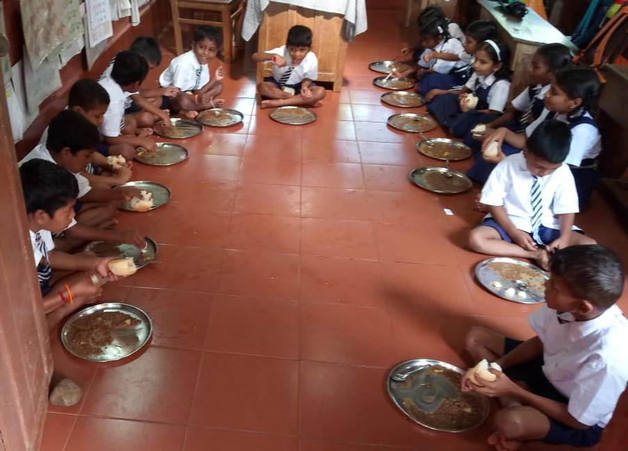
STUDENTS AVAILING MID DAY MEAL

Slide 28
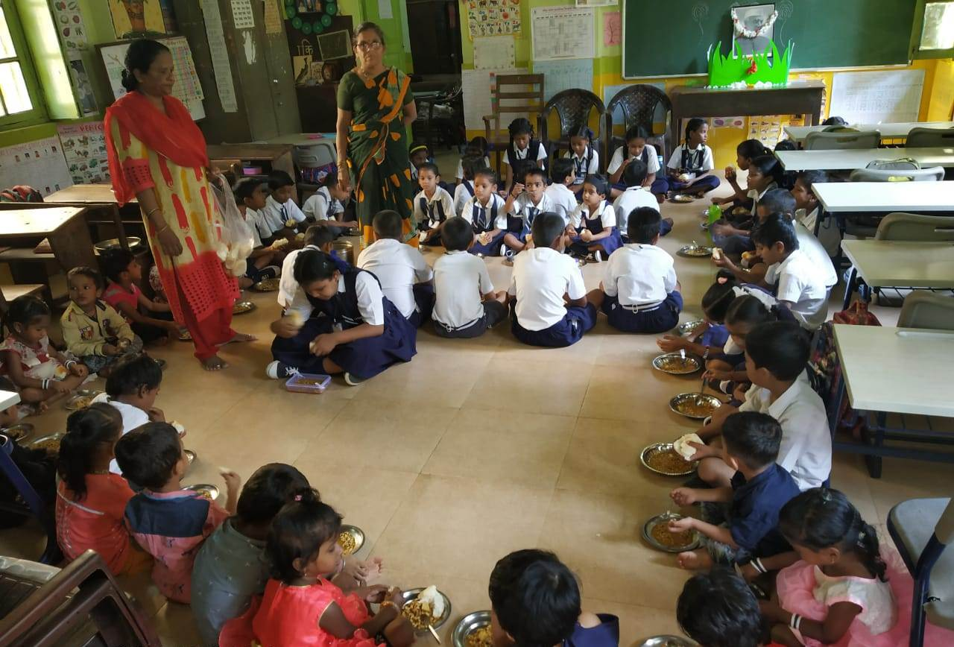
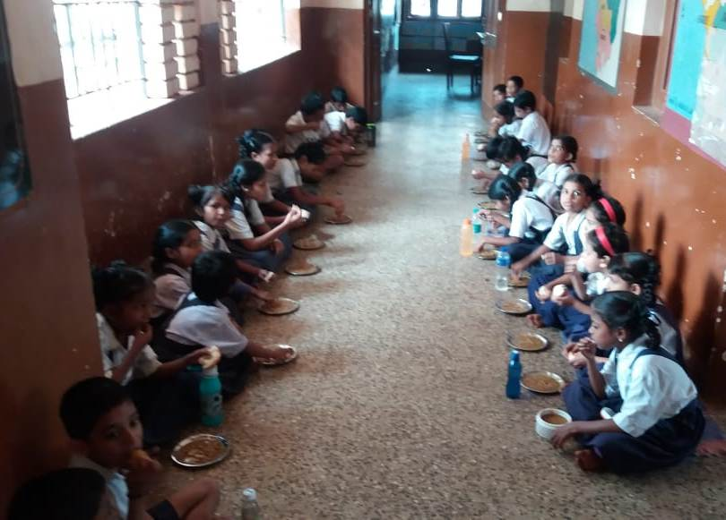

Slide 29
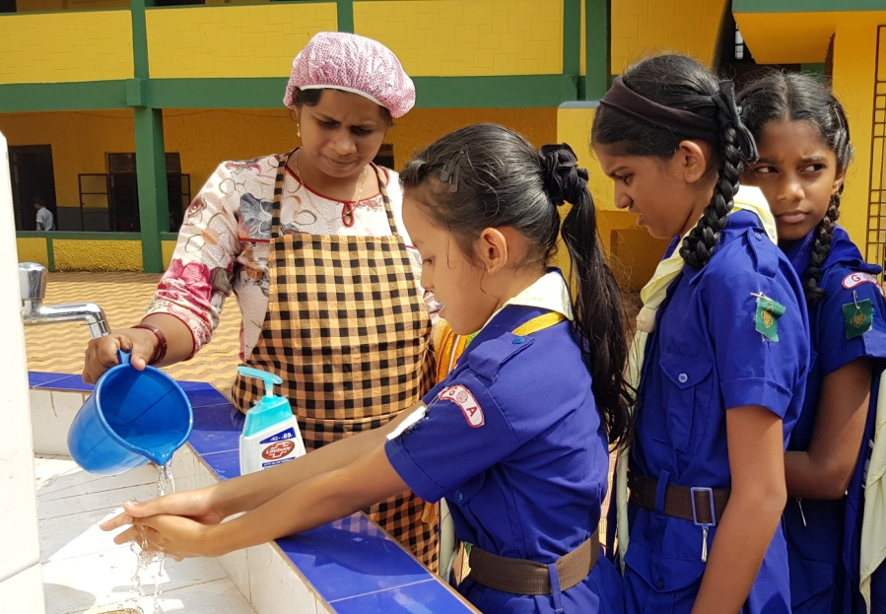
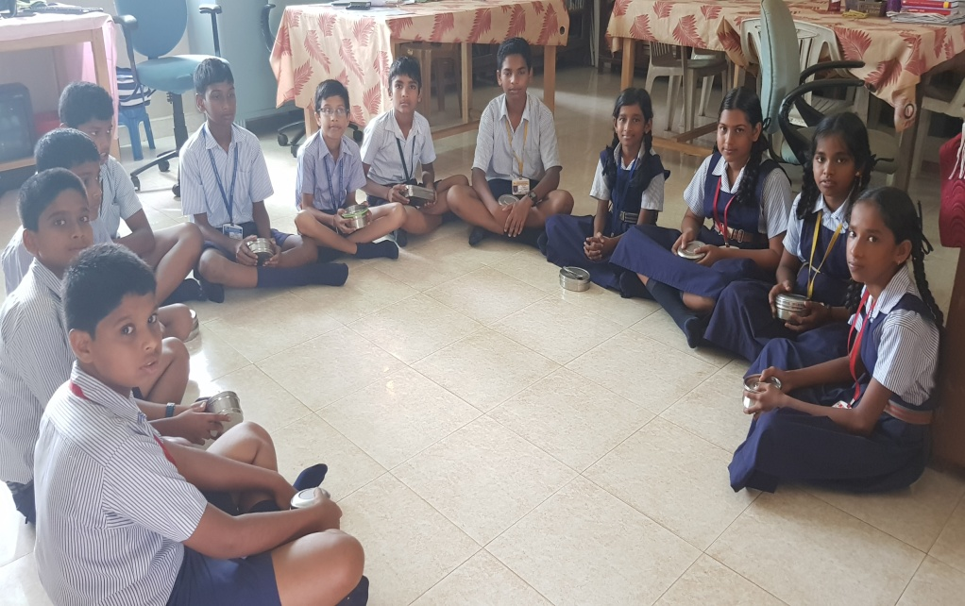
INSPECTIONS UNDER MID DAY MEAL SCHEME

Slide 30
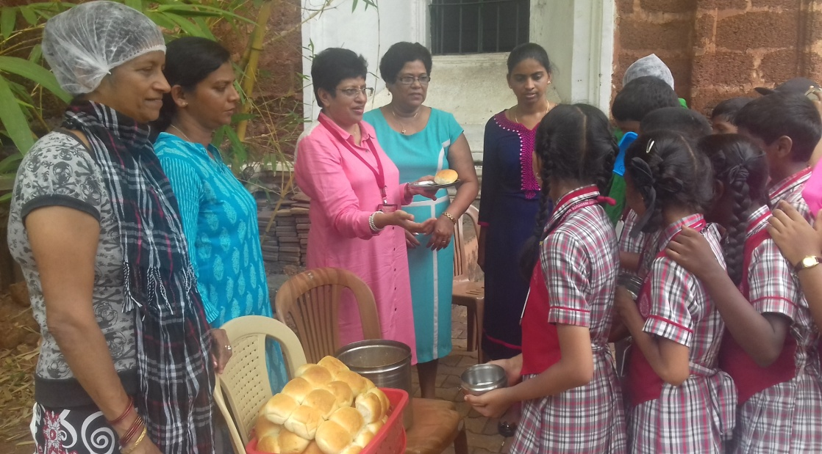
INSPECTIONS OF MID DAY MEAL

Slide 31
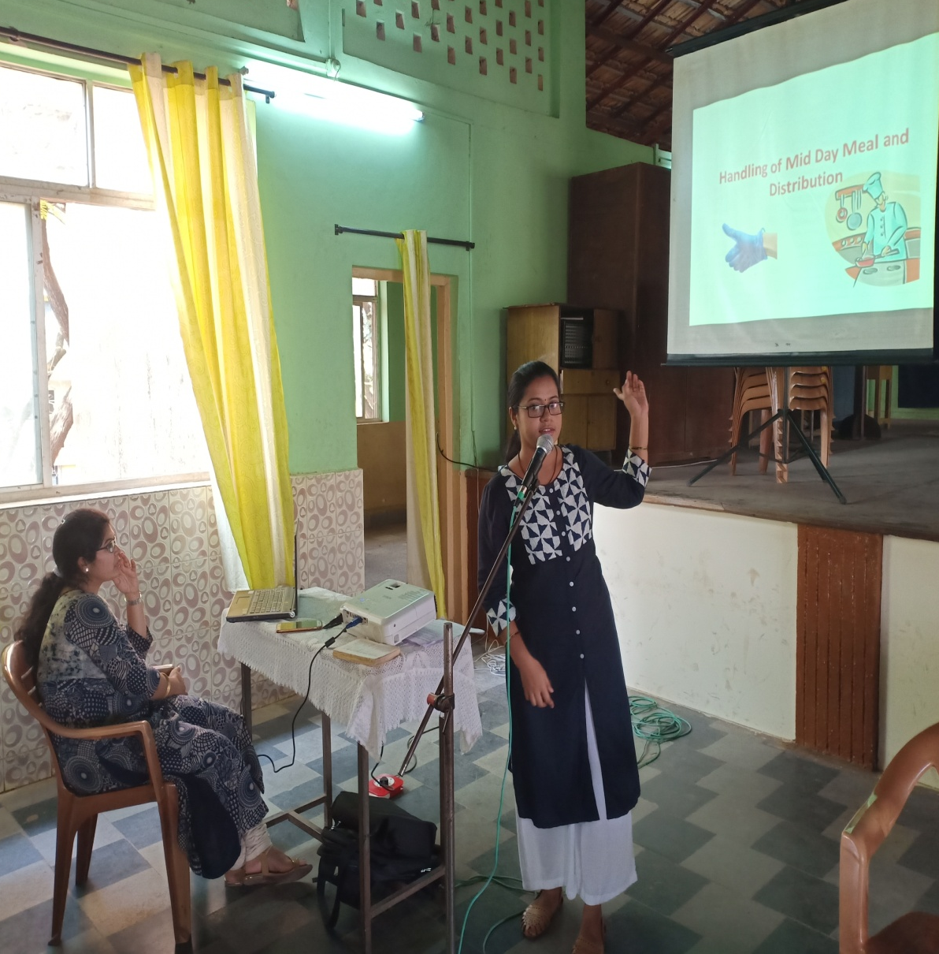
TRAINING GIVEN TO CCH ON FOOD SAFETY, HYGIENE AND DISTRIBUTION OF MID DAY MEAL

Slide 32
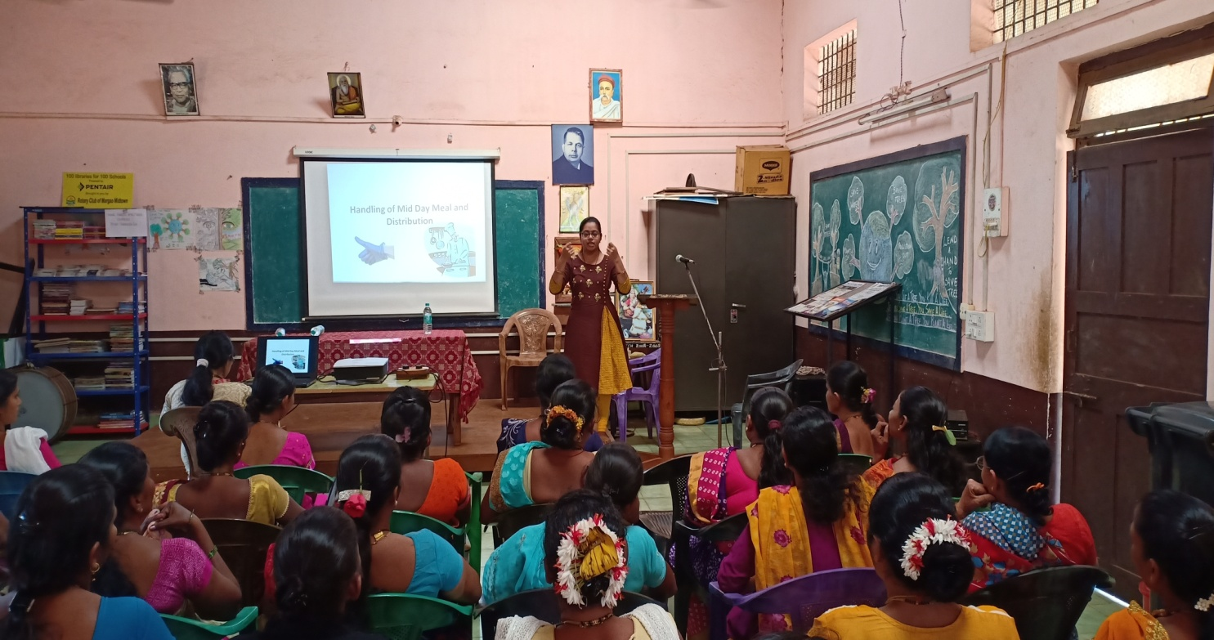

Slide 33
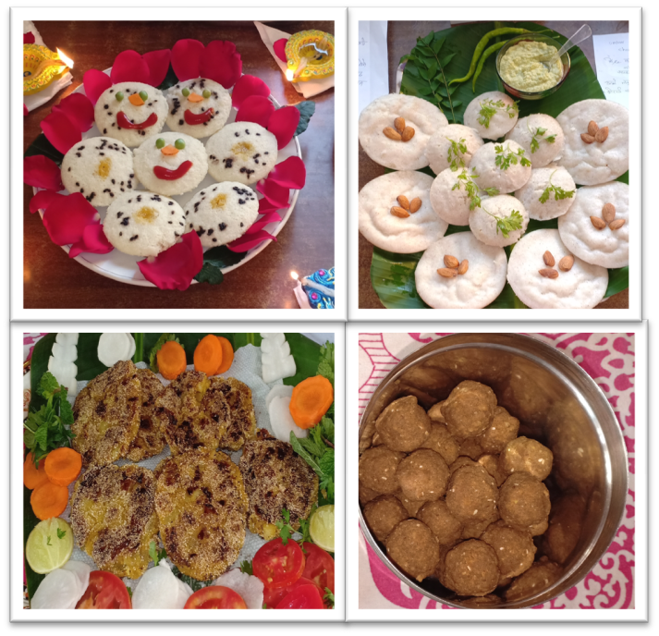
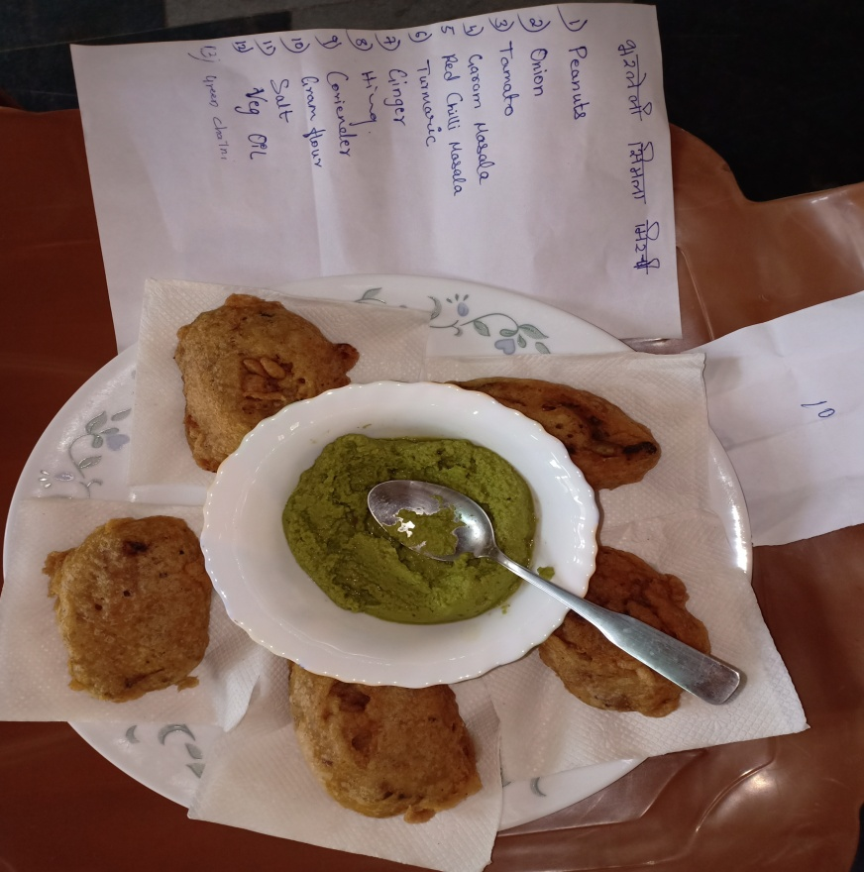
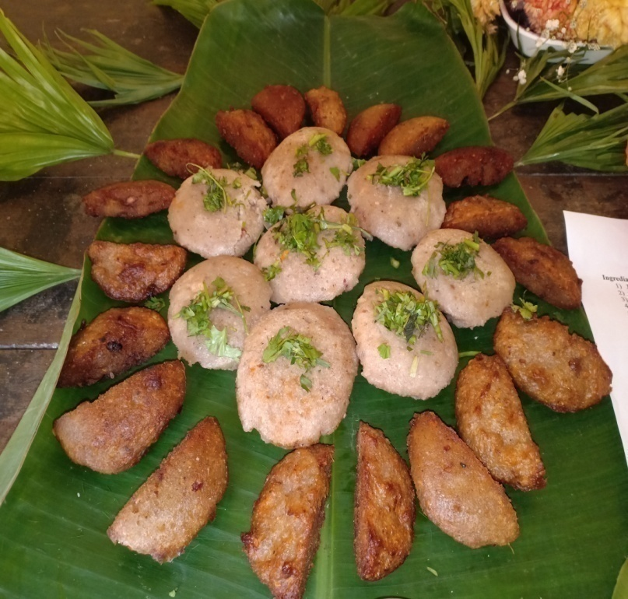
VARIOUS HEALTHY NUTRITIOUS RECIPES PRESENTED FOR COOKING COMPETITION

Slide 34
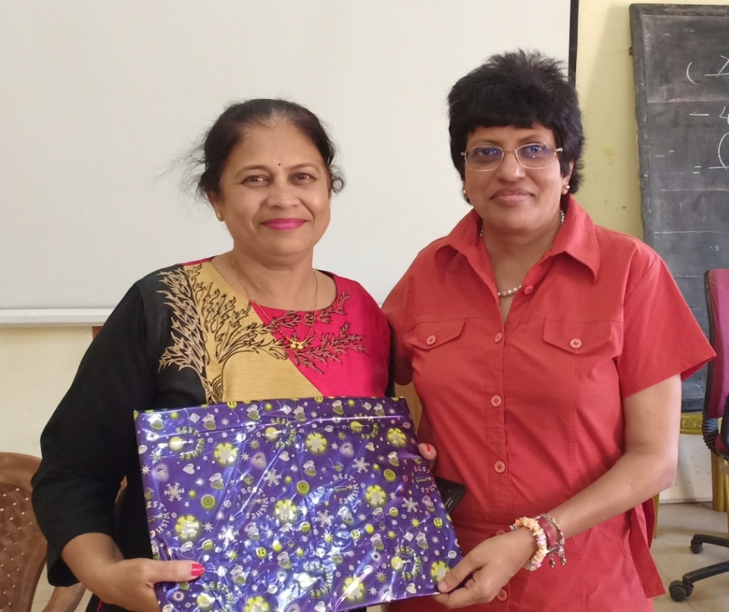
SOME OF THE WINNERS OF THE COMPETITIONS

Slide 35
THANK YOU

